Slide 1
DMPNN result
0613

Slide 2
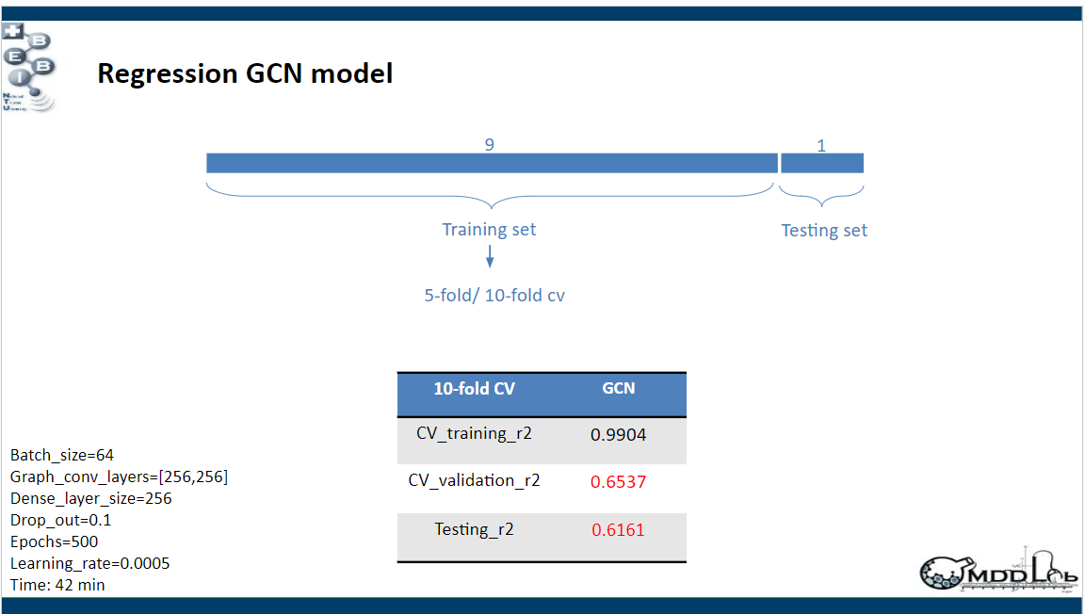
Previous result of Ju-Chun Huang

Slide 3
Hyper-parameter
Random seed: 1348, train & valid/ test: 0.9/0.1 of original dataset, 5 fold CV
opt_adam = optimizers.AdamW(learning_rate= 0.0001, weight_decay=0.00001)
model = dc.models.DMPNNModel( mode='regression',
depth=6,
enc_dropout_p= 0,
enc_hidden=1800,
ffn_dropout_p= 0,
ffn_hidden=1800,
ffn_layers= 2,
batch_size=50,
global_features_size=200,
optimizer=opt_adam,
device = 'cuda’ )

Slide 4
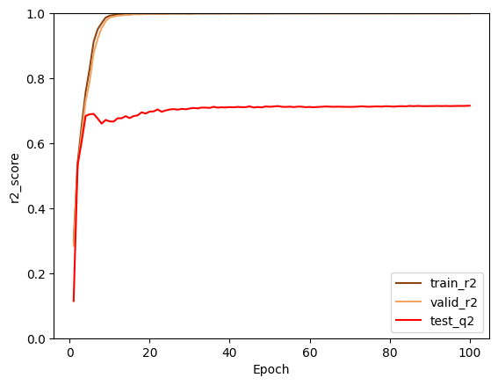
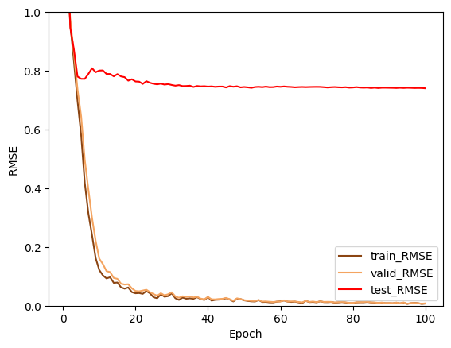
Training curve
Best r2
Train: 0.9999694703228853
Valid: 0.9999643046778764
Test: 0.7156135797634984
Best RMSE
Train: 0.007218157683449905
Valid: 0.008024131946602937
Test: 0.7402398537352587

Slide 5
Testing set result (1/10 of original dataset)
Y: half-life(min)
X: index
(in page 7)

Slide 6
Testing set result (1/10 of original dataset)

Slide 7
Difference
Difference in % :
(Pred-Observ)/Observ*100
(min)
(min)
Significant: If difference % > 50 assign 1

Slide 8
Continue

